Slide 1
The Decline of the Ottoman Empire 1878-1914
The Ottoman Empire, ruled by Muslims but containing large non-Muslim populations, had been in decline since at least 1878. Many of the Christian minorities in the Balkans sought thereafter to gain independence from the empire. The Ottoman Empire’s apparent weakness from 1878 to 1914 led many people to call it “the sick man of Europe.”
Notes:
1878-1914 This is the main bud

Slide 2
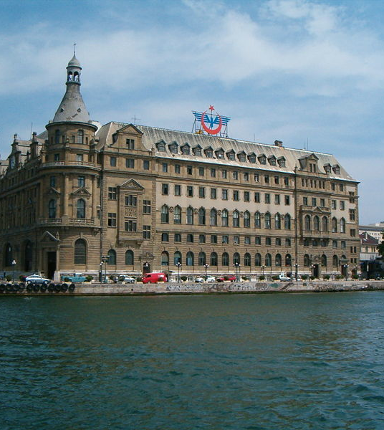
Relations with Germany
Both Germany and the Ottomans feared Russian military growth. Thus the two countries grew closer together in the years before 1914, although they did not sign an alliance until the war had begun, and the Ottomans also had economic and political links to Britain and France. Germany built Istanbul’s main train station in 1890 as part of a scheme to build a rail line from Berlin to Baghdad in the Ottoman province of Mesopotamia
http://www.turkeytravelresource.com/pub/article_images/800px_Haydarpasa_train_station.jpg
Notes:
We want to add this information to the main info bud

Slide 3
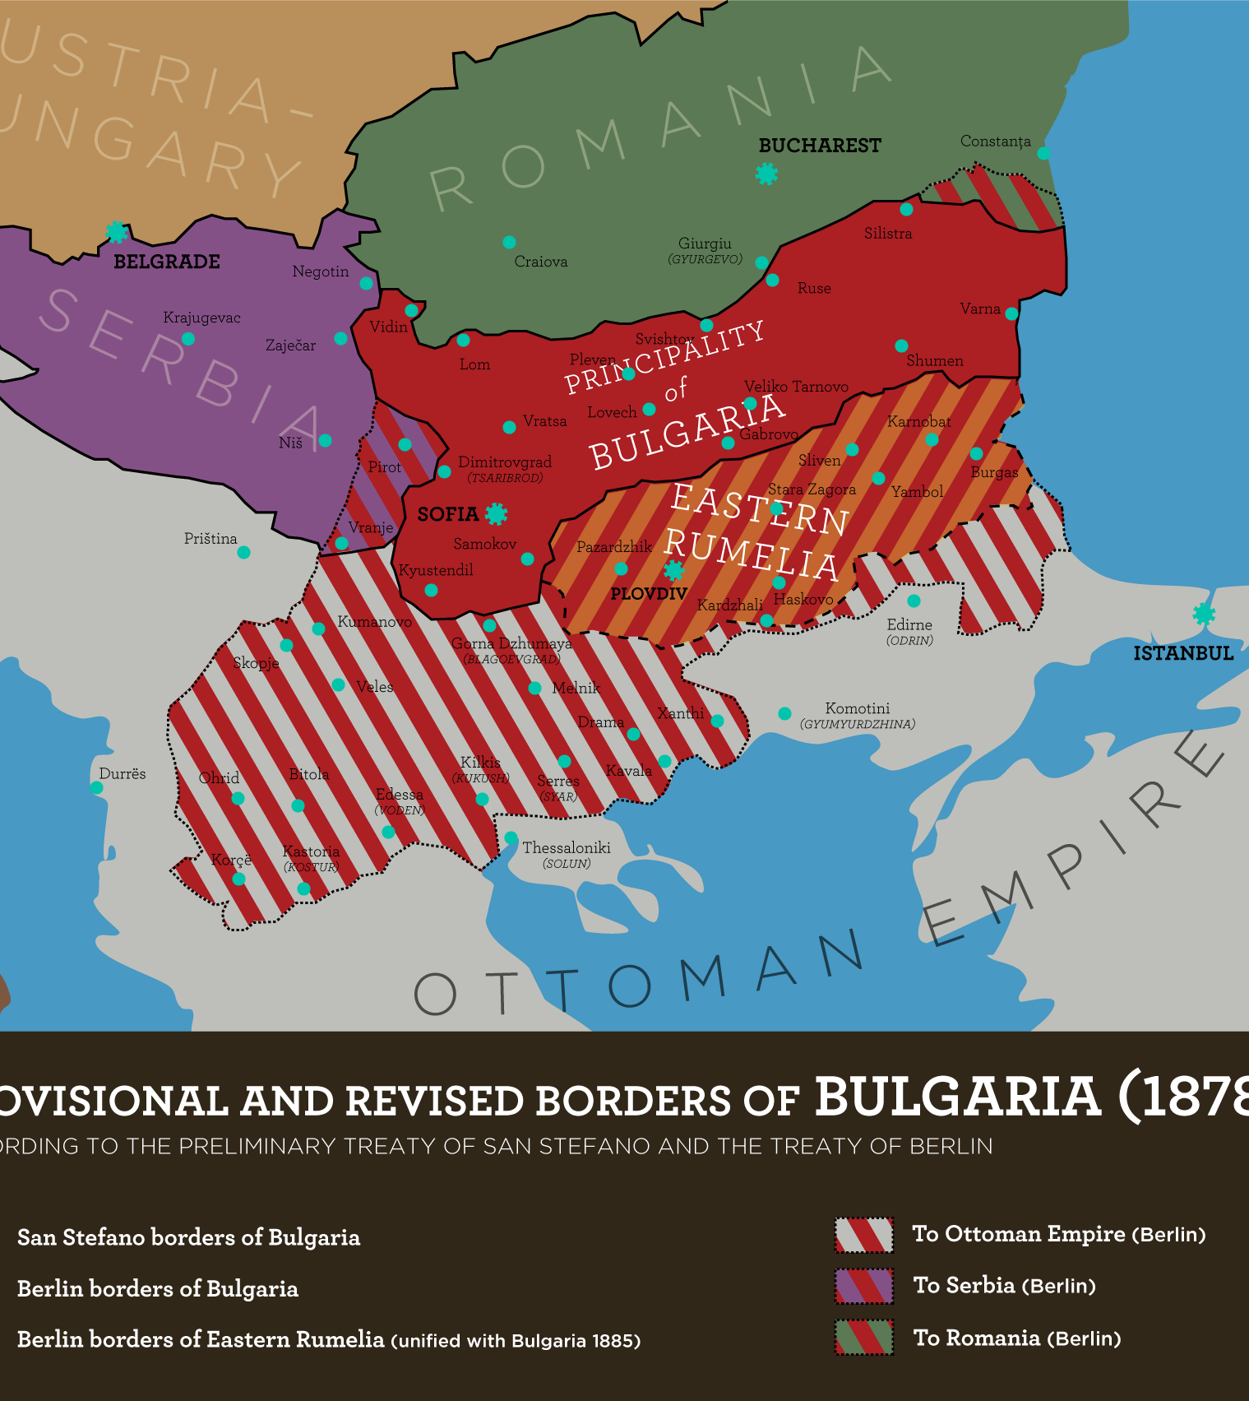
Treaty of San Stefano
Following the Russo-Turkish War from 1877-1878, a peace treaty was signed between Russia and the Ottoman Empire. The 1878 Treaty of San Stefano greatly reduced Ottoman power in Europe and created a thirst for indepen-dence among the Christian minorities in the Balkans.
http://upload.wikimedia.org/wikipedia/commons/e/ee/Bulgaria_San_Stefano_Berlin_1878_TB.png

Slide 4
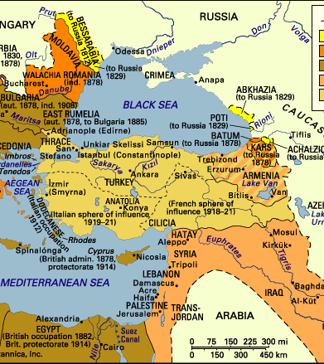
Map
We should have a map like this one that stops at 1914 to show the general decline of Ottoman power.
http://www.naqshbandi.org/ottomans/maps/declinemap.gif

Slide 5
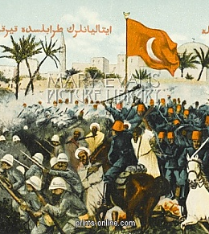
Italo-Libyan War
Italy took Libya from the Ottoman Empire in a war in 1911 and 1912. The war was unpopular in Italy and in Europe more generally because the Italian government had no justification for starting the war. The war made the Ottoman Empire look weak and inspired the Christian Balkan States to seize the moment and declare war on the Ottomans.
http://images.mediastorehouse.net/164/4400235_450_450_0_0_fit_6_83d8bd85302118e19d383526eb4a5c59.jpg

Slide 6
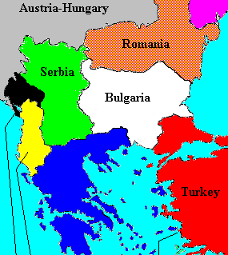
Balkan Wars
The Balkan Wars reduced the Ottoman Empire’s European territories to a small piece of eastern Thrace. Serbia emerged very powerful, although it still had no access to the sea. Many contemporaries thought that the empire would soon fall as a result of its many defeats.
http://www.transanatolie.com/english/turkey/turks/balkan6.gif
Notes:
1912-1913

Slide 7
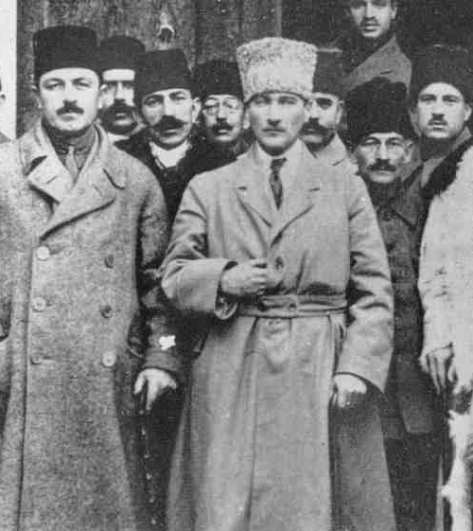
Young Turks - 1906
Partly in response to the Ottoman Empire’s decline, a new political movement known as the Young Turks, emerged. They had a broad political agenda that included modernization and a reform of the empire from a multi-ethnic one to an empire based largely around ethnically Turkish peoples. The Young Turks helped to bring energy and a sense of nationalism to the empire.
http://www.pstracks.com/wp-content/uploads/2013/05/the-young-turks.jpg
Notes:
1906

Slide 8
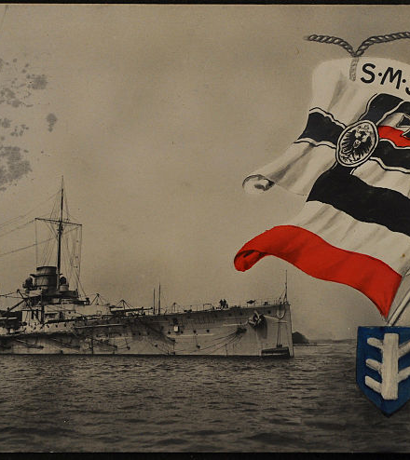
The Goeben and Breslau Incident August 3-10, 1914
When war began, Britain cancelled its sale of two modern warships to the Ottoman Empire. Germany responded by transferring two of its own ships, then trapped in the Mediterranean, to Ottoman control. The two ships cemented Ottoman-German relations and helped lead to the alliance that soon followed.
http://upload.wikimedia.org/wikipedia/commons/thumb/9/94/Schlachtschiff_%22SMS_Goeben%22%2C_item_1.jpg/800px-Schlachtschiff_%22SMS_Goeben%22%2C_item_1.jpg

